Slide 1
Smart Sorting : Roteen Fruits And Vegetables

Slide 2
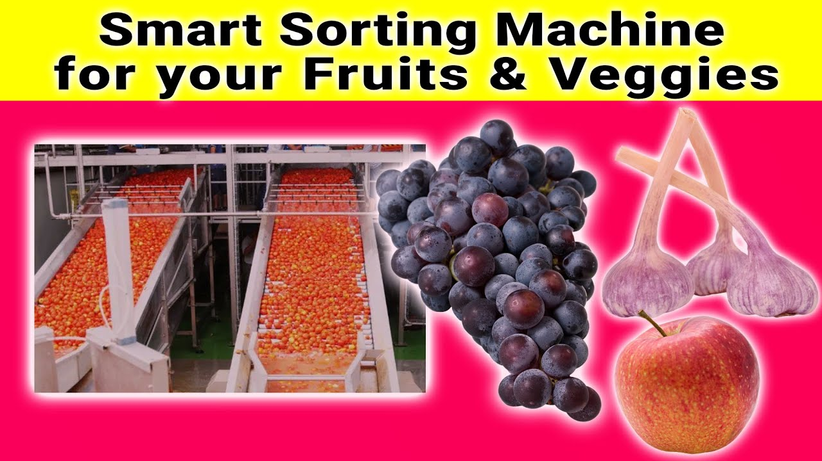
Introduction to Smart Sorting of Rotten Fruits and Vegetables
Smart sorting is an innovative technology used to identify and separate spoiled produce efficiently.
It employs advanced sensors and AI algorithms to ensure only fresh items reach consumers.
This process reduces waste and improves food safety across supply chains.
1
Notes:
Image source: https://i.ytimg.com

Slide 3
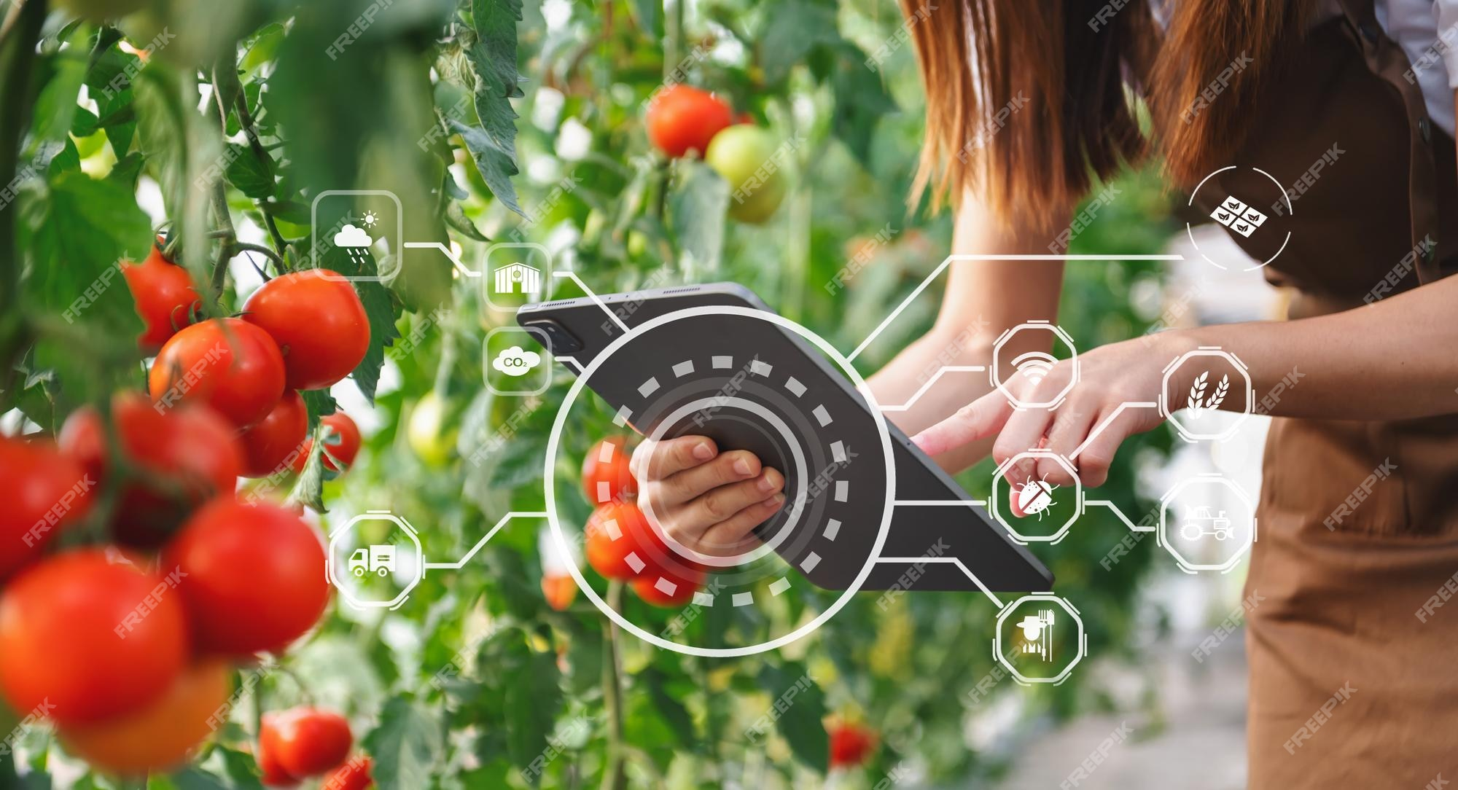
Importance of Proper Sorting in Agriculture
Proper sorting minimizes the risk of distributing contaminated or spoiled produce.
It helps in maintaining the quality and shelf life of fruits and vegetables.
Efficient sorting techniques can significantly reduce economic losses for farmers and vendors.
2
Notes:
Image source: https://img.freepik.com

Slide 4
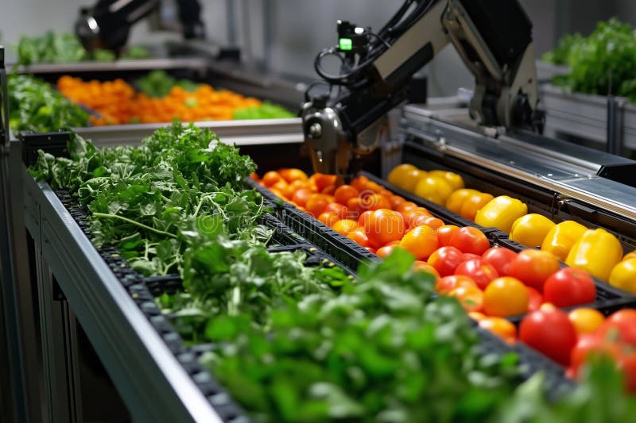
Technologies Used in Smart Sorting
Optical sensors and cameras are used to detect color, size, and surface defects.
Spectroscopy and machine learning algorithms analyze data to identify rotten produce.
Robotics and conveyor systems automate the sorting process for faster throughput.
3
Notes:
Image source: https://thumbs.dreamstime.com

Slide 5
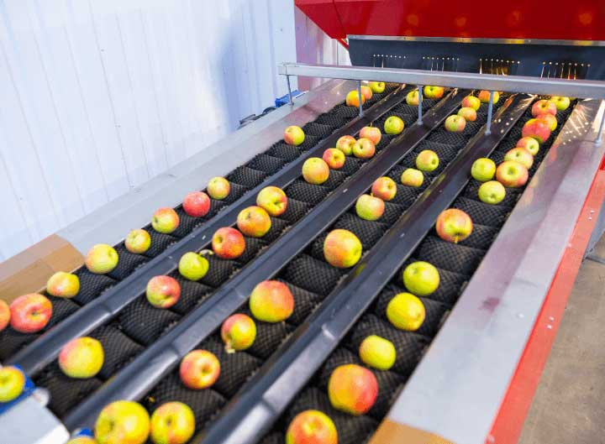
How Smart Sorting Detects Rotten Produce
Visual inspection algorithms detect discoloration, mold, or bruising on fruits and vegetables.
Chemical sensors can identify spoilage indicators like ethylene or ethyl alcohol.
Data from sensors is processed in real-time to make sorting decisions automatically.
4
Notes:
Image source: https://www.juicemakingmachine.com

Slide 6
Benefits of Smart Sorting Systems
These systems improve the accuracy of sorting, reducing human error.
They extend the freshness and quality of produce delivered to consumers.
Smart sorting reduces waste by accurately removing spoiled items early in the supply chain.
5
Notes:
Image source: https://www.juicemakingmachine.com

Slide 7
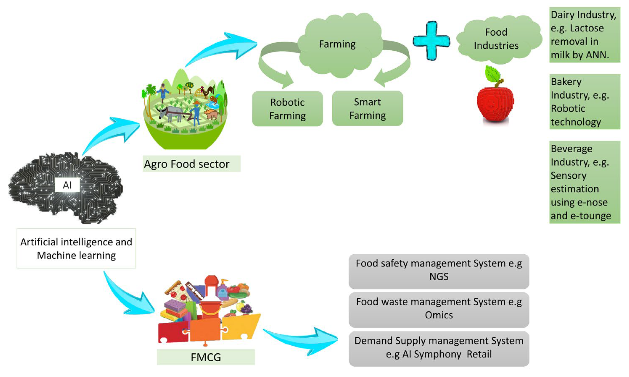
Challenges in Implementing Smart Sorting
High initial costs of advanced sensors and automation equipment can be a barrier.
Variability in produce appearance makes it difficult for AI systems to achieve perfect accuracy.
Continuous updates and maintenance are required to keep systems effective and reliable.
6
Notes:
Image source: https://www.mdpi.com

Slide 8
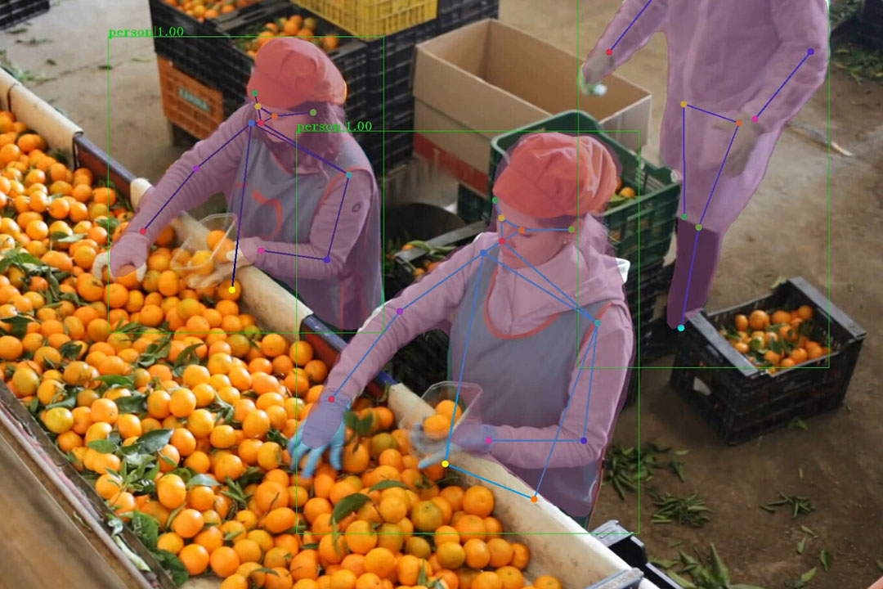
Case Studies and Industry Applications
Several supermarkets have adopted smart sorting to ensure only fresh produce is displayed.
Farms utilize robotic sorting lines to process large quantities of fruits and vegetables efficiently.
Food distributors leverage these technologies to minimize spoilage during transportation.
7
Notes:
Image source: https://www.futurefarming.com

Slide 9
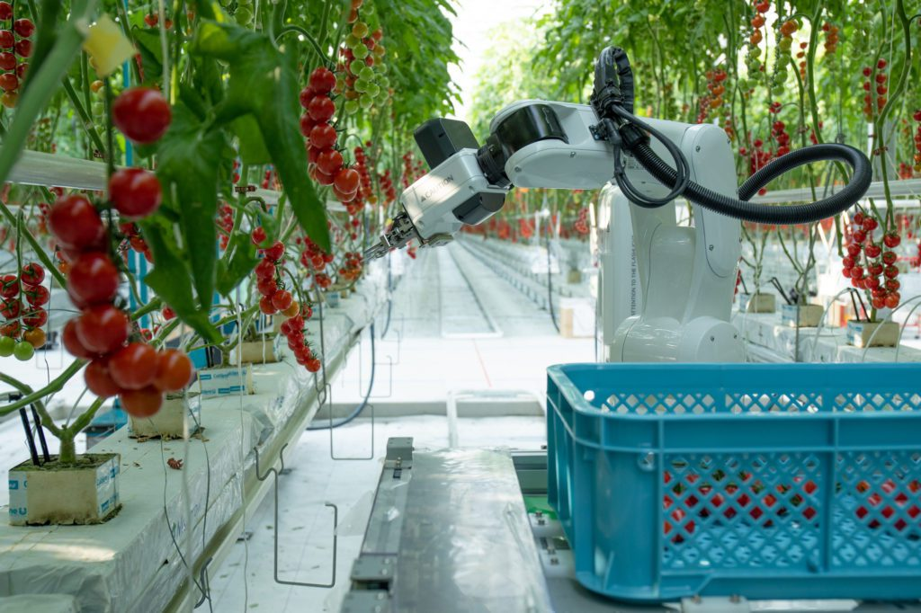
Future Trends in Smart Sorting Technology
Integration of IoT devices for real-time monitoring and data collection is expected to grow.
Advances in AI will enhance the ability to detect subtle signs of spoilage.
Sustainable practices will benefit from smarter sorting, reducing overall food waste.
8
Notes:
Image source: https://vegetablegrowersnews.com

Slide 10
Conclusion
Smart sorting is transforming the way produce is graded and distributed globally.
The combination of sensors, AI, and robotics offers a promising solution to reduce waste.
Continued innovation will lead to more efficient, cost-effective, and sustainable food systems.
9
Notes:
Image source: https://www.futurefarming.com

Slide 11
References
"Smart Sorting Technologies in Agriculture," Journal of Food Engineering, 2022.
"Advances in Produce Sorting Systems," International Food Science Review, 2023.
"Reducing Food Waste with Automated Sorting," Agricultural Automation Magazine, 2021.
10

